Slide 1

E Washington Ave Redesign
Zoey Yandell

Slide 2
Site Analysis

Slide 3
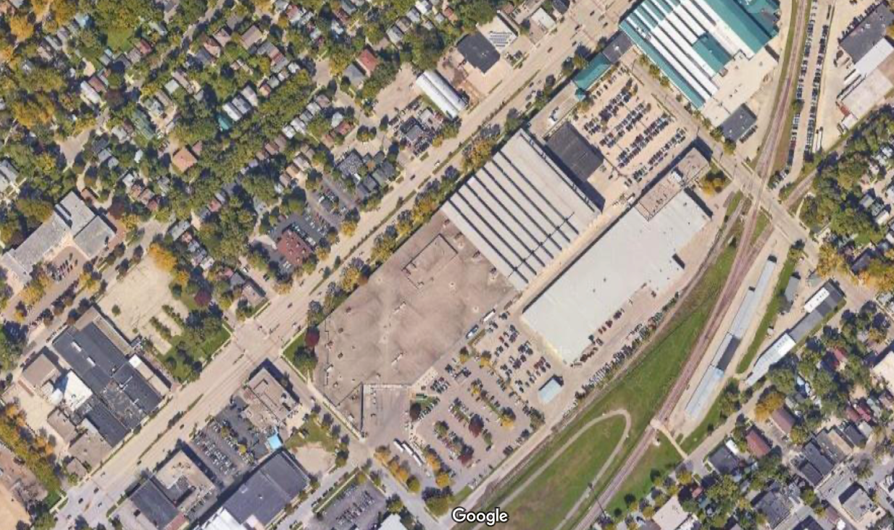
Lapham Elementary School
Madison Youth Arts
Madison Metro Transit System
Key
education
utility
café/restaurant
bus stop
intersecting street
problem intersection

Slide 4
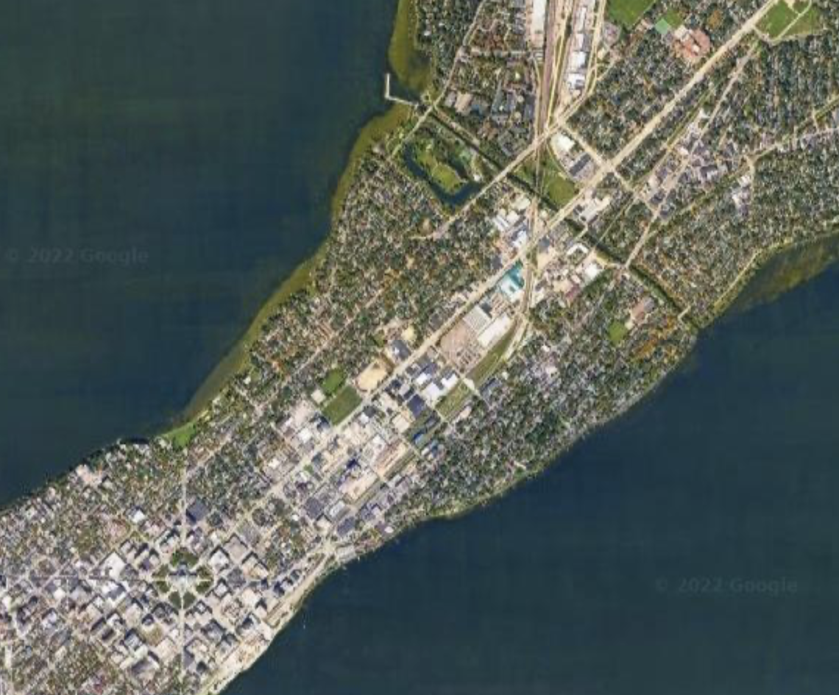
East Washington Ave/HWY 151
This 6-lane highway goes directly through Madison towards the State Capitol, passing closely by a high school, multiple elementary schools, and a quickly developing commercial district with concert venues, restaurants, hotels, and many developments planned for the near future. It is a highly trafficked area. Students cross it on their way to school, activities, and sports games; people who live in the nearby residential neighborhoods get off the bus here, and every day people pick up coffee and food here.
At the same time, this is one of the most dangerous streets in Madison. There were six deaths along the entire stretch of the street in 2021. It is known for dangerous intersections and drag racing along the street at night. Residents feel unsafe walking in the area, and some have even moved because of walkability concerns (Jolles, 2022).

Slide 5
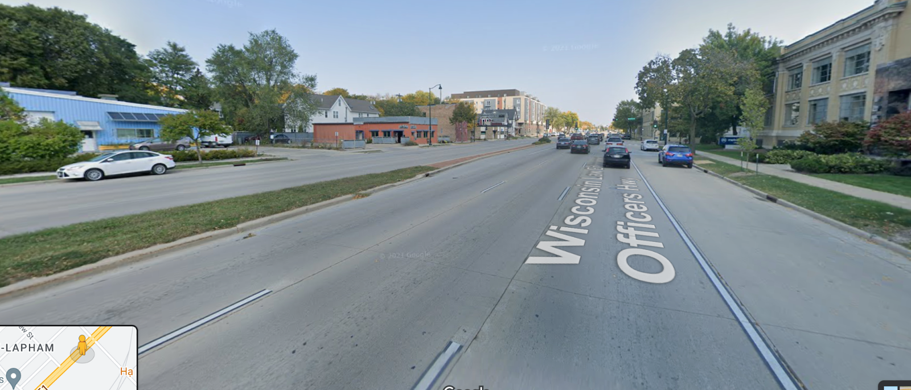
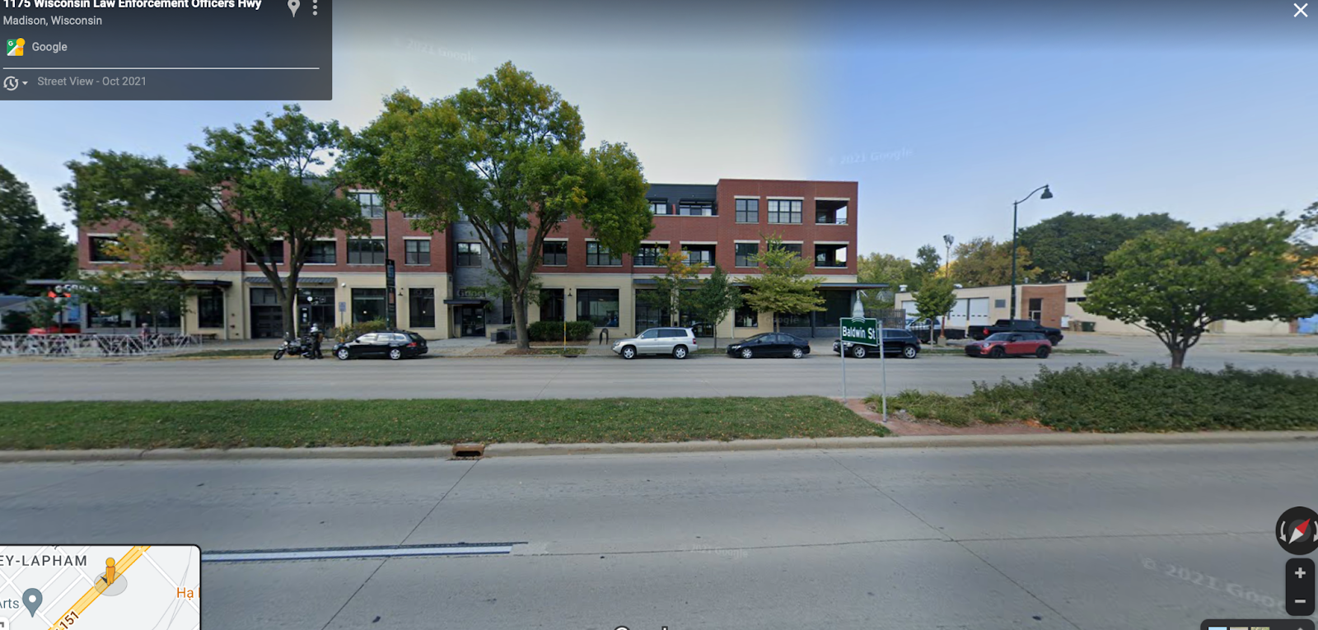
A Highway in the City
The design of the street certainly doesn’t discourage speeding. The three wide lanes in each direction and long stretches of road allow cars to drive quickly and recklessly.
Compare those wide lanes with the thin medians and sidewalks, despite the high volume of pedestrians.
Although bicyclists do ride on this street, the bike lane isn’t differentiated from the parking lane.
Wisconsin Law Enforcement Officer’s HWY: Stretches of E Wash were given this commemorative name in 2003. The name was renewed in 2015, the same year a Madison police officer shot and killed a teenage Black man named Tony Robinson who had gone to East High School down the street.

Slide 6
12 Quality Criteria
Traffic and Accidents
2
Sit and Stay
7
Talk and Listen
8
Positive aspects of Climate
8
Walk and Bike
4
Human Scale
6
Things to see
5
Play and Exercise
8
Connect-ivity
10
Positive sensory experiences
8
Perception of Safety
5
Weather
7

Slide 7
Zooming in on Problem Areas
Both these factors are strongly impacted by the car-centric design. While the buildings themselves are generally human scale, the six-lane highway overall gives the impression of a wide, inhospitable band of emptiness. In addition, the cars rushing past are hardly pleasant to look at.
Human Scale
6
Traffic and Accidents
2
As mentioned in previous slides, East Washington is one of the most dangerous streets in Madison for pedestrians. Intersections are particularly problematic.
Walk and Bike
4
In addition to the danger of intersections, the street itself is unpleasant to walk or bike on. Pedestrian sidewalks are narrow, and the bike lane is right next to three lanes of speeding cars.
Things to see
5
The wide, car-focused street design makes the street feel both more open and less observed. The lack of pedestrian ownership means fewer eyes on the street and concerns of safety (not just from cars) when, for example, walking alone to get a coffee.
Perception of Safety
5

Slide 8
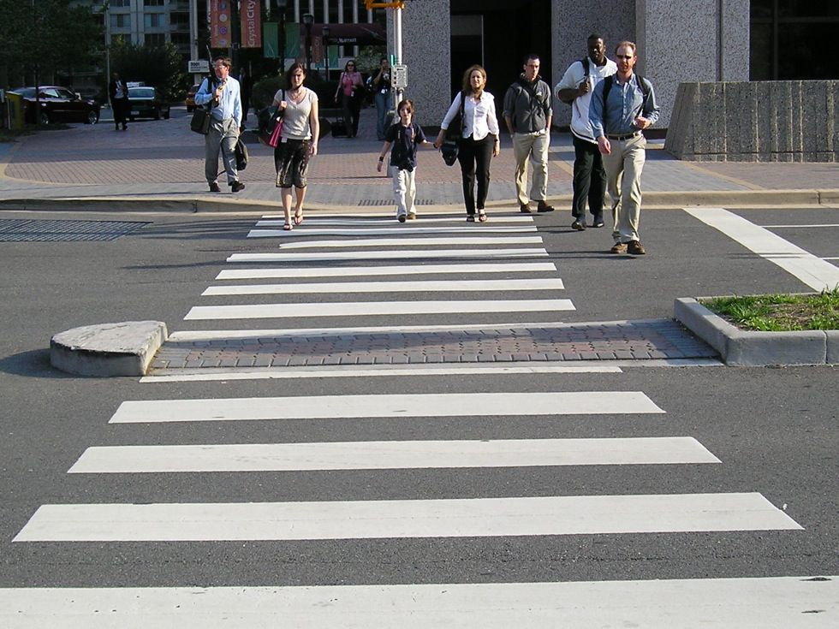
Current Initiatives: Vision Zero, BRT and Zoning
Vision Zero: Madison is one of many cities adopting a goal of zero traffic accidents by 2035. It has already completed some initiatives for this stretch of East Washington (Department of Transportation, 2022):
Speed limit reduced to 30mph (50kph)
Traffic signals retimed to promote speed reduction
Crosswalks changed to “continental” crosswalks (see image)
In addition, the Vision Zero plan includes a goal of adding traffic calming measures to problem streets like East Wash.
BRT: Madison is finally getting a Bus Rapid Transit system as part of a controversial public transit overhaul. This involves new BRT stops and dedicated lanes along East Wash (Mosiman, 2022; Robinson, 2022). The stops are being installed currently. If Vision Zero and BRT had been planned concurrently, this would have been an ideal time to add traffic calming measures, while construction is already occurring.
Zoning: Changes are being made to remove minimum parking requirements for residential homes near major transit areas, allowing homes to be built with the expectation of primarily using public transit rather than cars. In addition, new zoning regulations will allow for multi-family housing in previously single-family areas. This will increase residential pedestrian traffic in this and other stretches of East Washington (Robinson, 2022).

Slide 9
Strategies

Slide 10
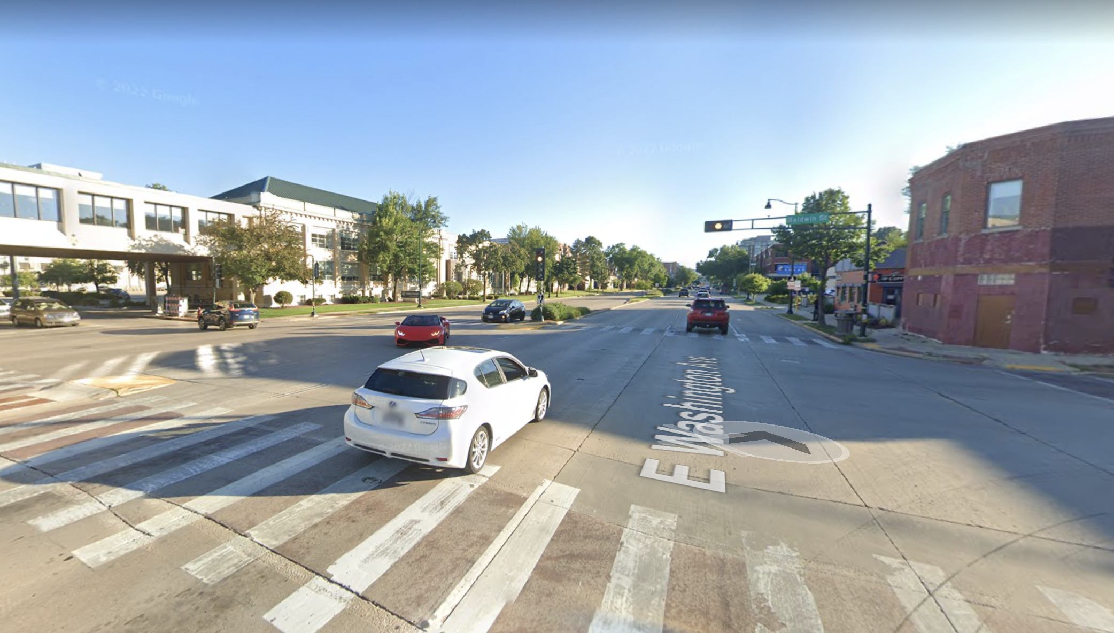
Pedestrianization
“I walk all the time. I work on campus, so always walking, and when you can’t even cross your street at a light because you’re worried that somebody might blow that light. It’s kind of scary.” - Mandy Morrow, E Wash resident (Jolles, 2022)
East Washington urgently needs to become safer and more welcoming to pedestrians. Not only do dangerous intersections pose a very real risk to pedestrians, but the lack of walkability also drives away residents. Morrow ended up moving out of the neighborhood because of the danger East Wash posed. As the street becomes a transit corridor and welcomes new pedestrian transit from BRT and zoning changes, pedestrian safety must become a paramount concern.
Changing street design to prioritize pedestrians will also improve its efficiency. Streets that provide different types of transit, such as walking, biking, and public transit, as well as driving, will move more people while also improving accessibility and reducing greenhouse gas production (Global street design guide, 2016).

Slide 11
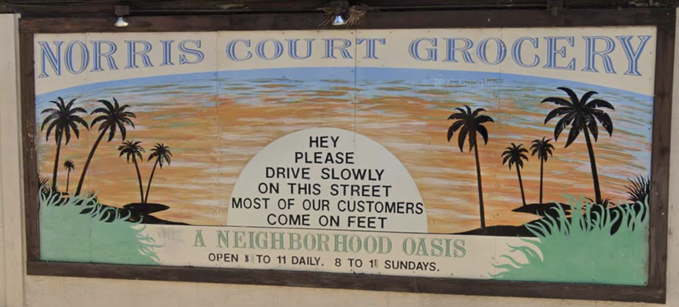
Pedestrianization and Businesses
This corridor of East Washington, as well as the stretch moving west towards the State Capitol, is home to many local businesses, such as coffeeshops, restaurants, and, further on, a popular concert venue. Historically, businesses have not survived long in this area of East Washington. The competitive Madison restaurant economy means that businesses, such as my former favorite coffeeshop, that cannot attract enough customers must raise prices or close down.
Increased pedestrian traffic on this street will bring more customers to these local businesses. People who walk, cycle or use public transit are more likely to stop in the area that people who travel by car (Global street design guide, 2016).
That’s the reason that a nearby grocery on another busy street sports this mural asking cars to respect their pedestrian customers!

Slide 12
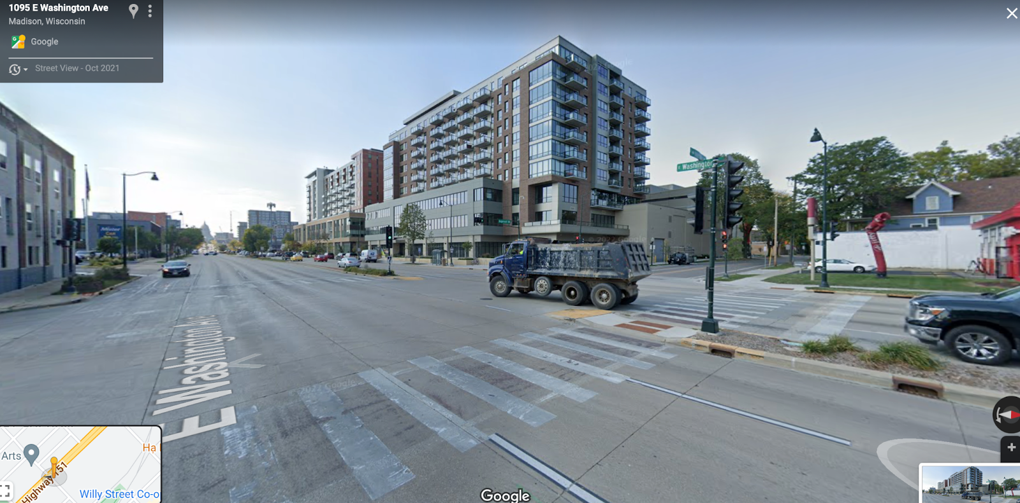
Crosswalk timings prioritize motor vehicles
“Large intersections are often designed for dangerous, high-speed turning” (Global street design guide, 2016, pp. 11)
No bike crossing markings
Thin medians don’t leave pedestrians enough room to wait

Slide 13
How to Pedestrianize
While decreasing speed limits, changing crossing lights, and improving crosswalk markings is a good start, these measures alone won’t address the issues on East Washington. The fact remains that the design of the street itself encourages speeding and disregard of pedestrians. As the Global Street Design Guide says, “a street cannot be made safe if it has been designed to prevent people from making safe decisions.” (11) The failures of this street have proven that a six-lane highway with wide lanes and infrequent intersections does not belong in the center of a city. In fact, the Global Street Design Guide highlights “highway-like surface streets where motorcyclists and public transit passengers are at risk from large speed differentials, and where sidewalks are missing or substandard” as especially dangerous for pedestrians.
Design solutions must be implemented to calm traffic and improve pedestrian safety. These may include:
Removing a lane of traffic to turn the street from a six-lane to a four-lane highway, perhaps replacing it with a bus lane
Narrowing lanes to force cars to drive slower - 3m lane width is recommended (National Association of City Transportation Officials [NACTO], 2013d)
Widening traffic islands at intersections to give pedestrians more space to wait (NACTO, 2013a)
Moving back stop bars so cars must give pedestrians more space
Extending curbs so pedestrians don’t have to cross as far (NACTO, 2013b)
Adding a signal to the Few Street midblock crossing to facilitate easier pedestrian movement and force cars to drive slowly and with more awareness of surroundings (NACTO, 2013c)

Slide 14
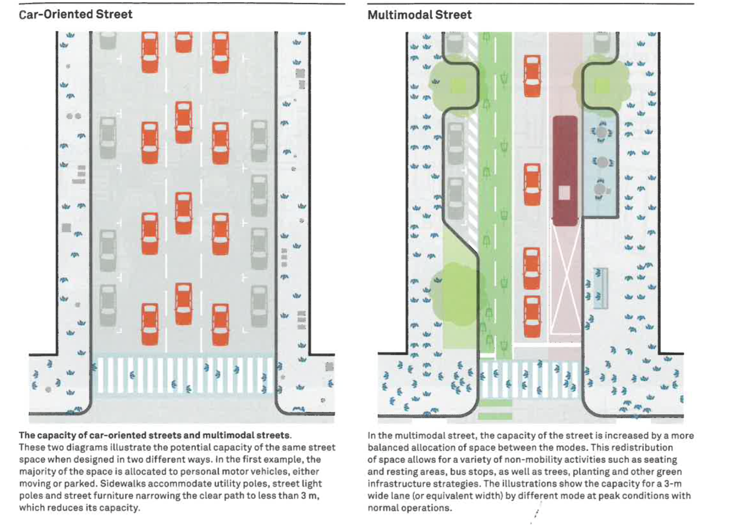
Like East Washington, this street design example from the Global Street Design Guide starts with three driving lanes (in this case only in one direction), parking on either side, and narrow sidewalks. The redesign prioritizes pedestrians and multimodal transport.

Slide 15
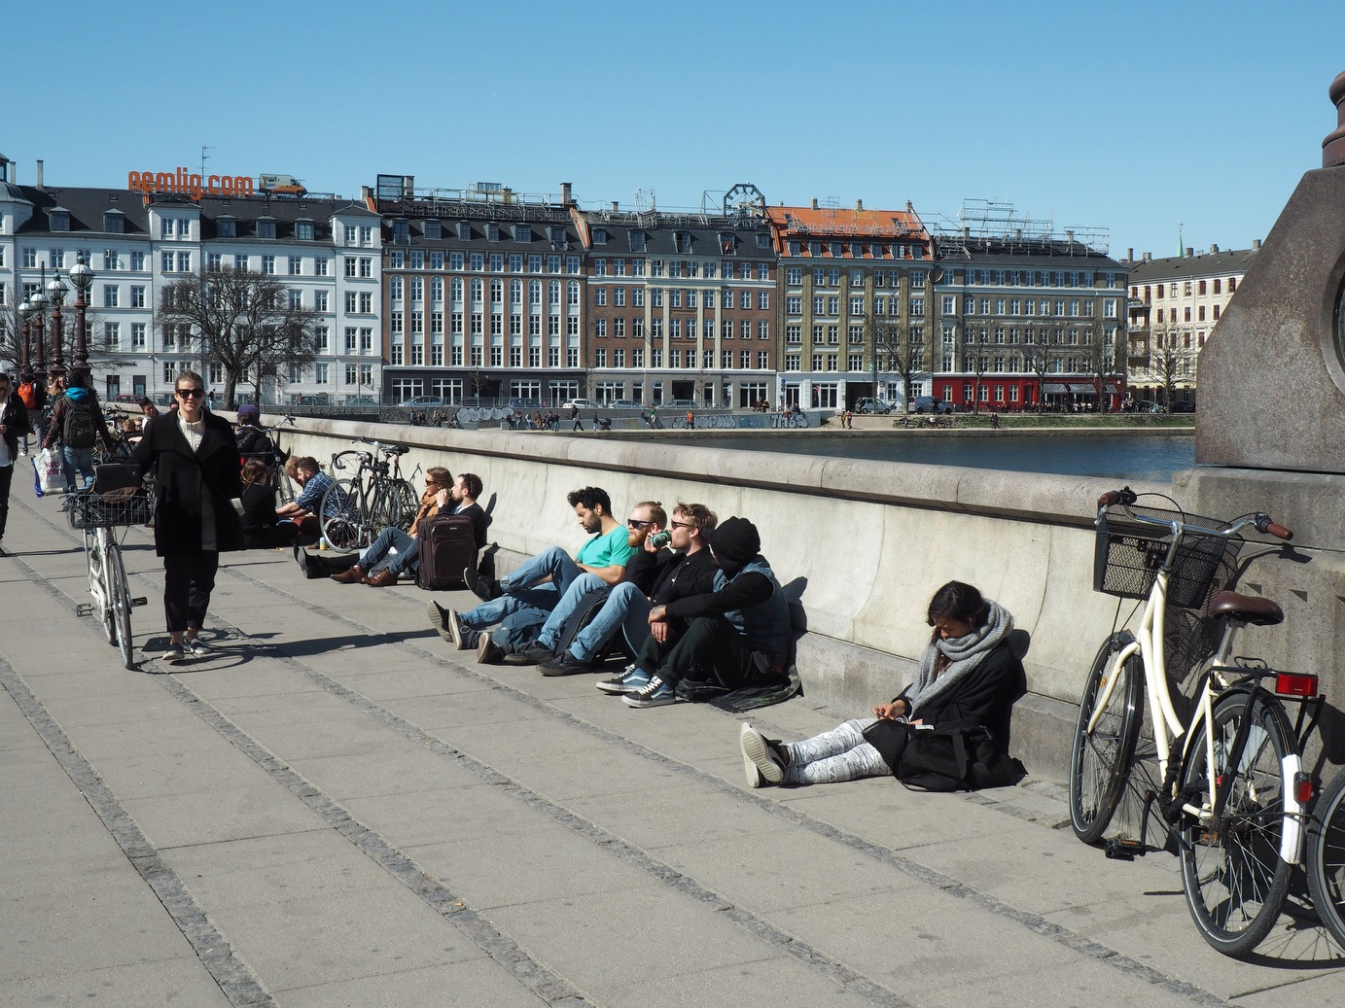
Case Study: Dronning Louises Bridge
The renovation of Dronning Louises Bro, in inner Copenhagen, turned the bridge from a car-centered street to a multimodal area now used frequently by bikes and especially by pedestrians. It has been made into a place where people want to both walk and stay (VisitCopenhagen).
The bridge has a wide sidewalk with plenty of room for heavy foot traffic and benches for people to sit, although as seen in this picture, the demand for seating is higher than expected. A wide raised bicycle lane is between pedestrians and cars, providing a buffer both in reality and in perception.
The pedestrianization of Dronning Louises Bro has resulted in higher traffic on the street, as bicyclists and pedestrians take up less space than cars and more of them can pass through the street at once. It has also created a popular public space that people enjoy spending time in.
Image credit: http://spacing.ca/national/wp-content/uploads/sites/3/IMG_7923.jpg

Slide 16
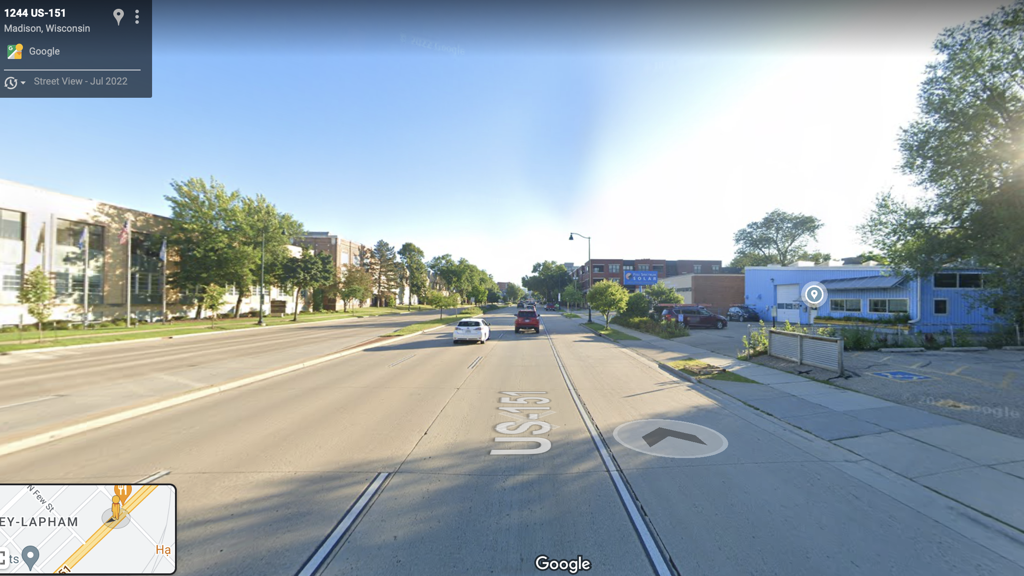
Human Scale
Most of the current traffic on East Washington is cars driving at about 50 km/hr. This means that the street is largely built with that scale, what Jan Gehl (2010) calls “car scale”, in mind. The wide road and (relatively) tall buildings make humans feel small and unprotected. This is especially true when crossing the street, but also extends to pedestrians walking along the sidewalk. They may feel alone, even when surrounded by other people in cars zipping past.
This sense of isolation in turn leads to a lower perception of safety. Jane Jacobs (1961) described the feeling of “eyes on the street”, which leads to more welcoming and safer-feeling neighborhoods. East Washington suffers not from a lack of eyes on the street but from the wrong kind of eyes: hurried drivers who don’t have time to stop and respond to anything happening. They are not participants in the life of the street but observers who move past too quickly to be involved.

Slide 17
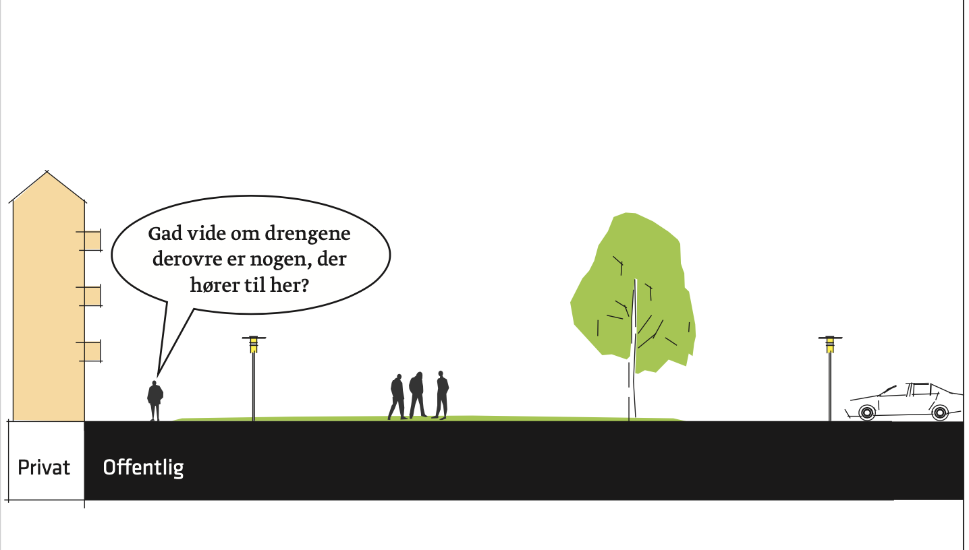
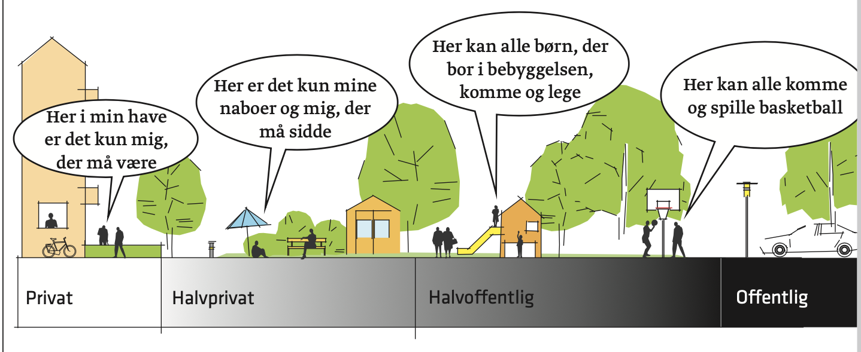
While this visual is intended for a residential area, the principle of a gradual shift from buildings to roads can apply to changing the scale of East Washington.
Currently, the street looks more like the first picture, with an expanse of open space directly against buildings (or even extending into empty parking lots). By adding some human-scale intercessions between the two, such as more greenery, outdoor dining, or parklets, East Washington can be made much more friendly to human travelers.
Image source: Boliger (see Sources Cited)

Slide 18
Human Scale and Pedestrianization: Synergy
Adding greenery in place of parking spaces can create a buffer between pedestrians and cars and add a transition area between buildings and road
Interventions to improve human scale can aid pedestrianization by making the space more welcoming and interesting to pedestrians, which in turn will positively impact both eyes on the street and actual safety – there is, after all, safety in numbers. At the same time, efforts to improve pedestrianization can help bring the street down to the human scale.
Room for outdoor dining creates human-level interest and ownership over the space
Removing a car lane for wider sidewalks and bike or bus lanes takes away some of the perceived expanse of the street

Slide 19
Design Strategies and Perception of Safety
Jacobs (1961) presented three important factors to making a street feel safe: eyes on the street, demarcation between public and private space, and regular users on the sidewalk. Improving human scale and pedestrianization can address all three of these factors.
Eyes on the street: This part of East Wash is right next to a residential neighborhood and contains several cafes with some outdoor seating. If residents and customers felt safer walking on the street, and if they had places to sit and stay, we would get more consistent eyes on the street.
Public/private divide: As demonstrated in the previous slide, improvements to human scale can create an organic and gradual divide between the semi-public or private space of businesses and the public space of the street itself.
Regular use: Improved pedestrianization will draw walkers to use this already-central street more frequently, and to patronize the commercial businesses that do exist. Traffic calming measures especially will make many pedestrians feel safer using this street at night, when it is usually plagued with reckless drivers.

Slide 20
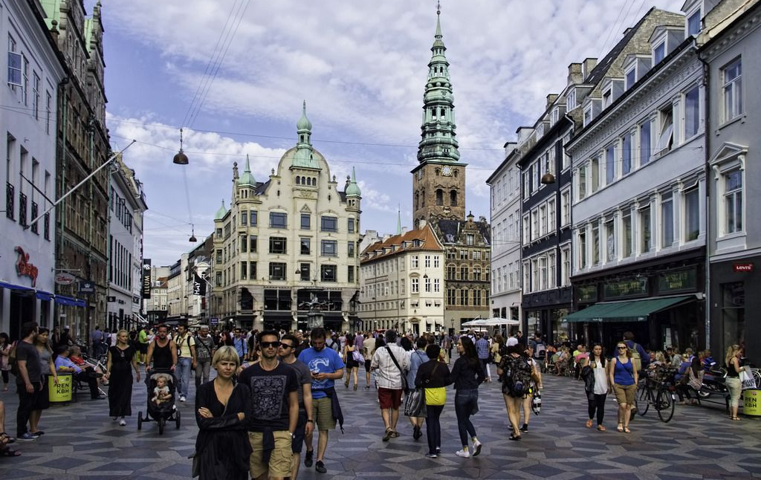
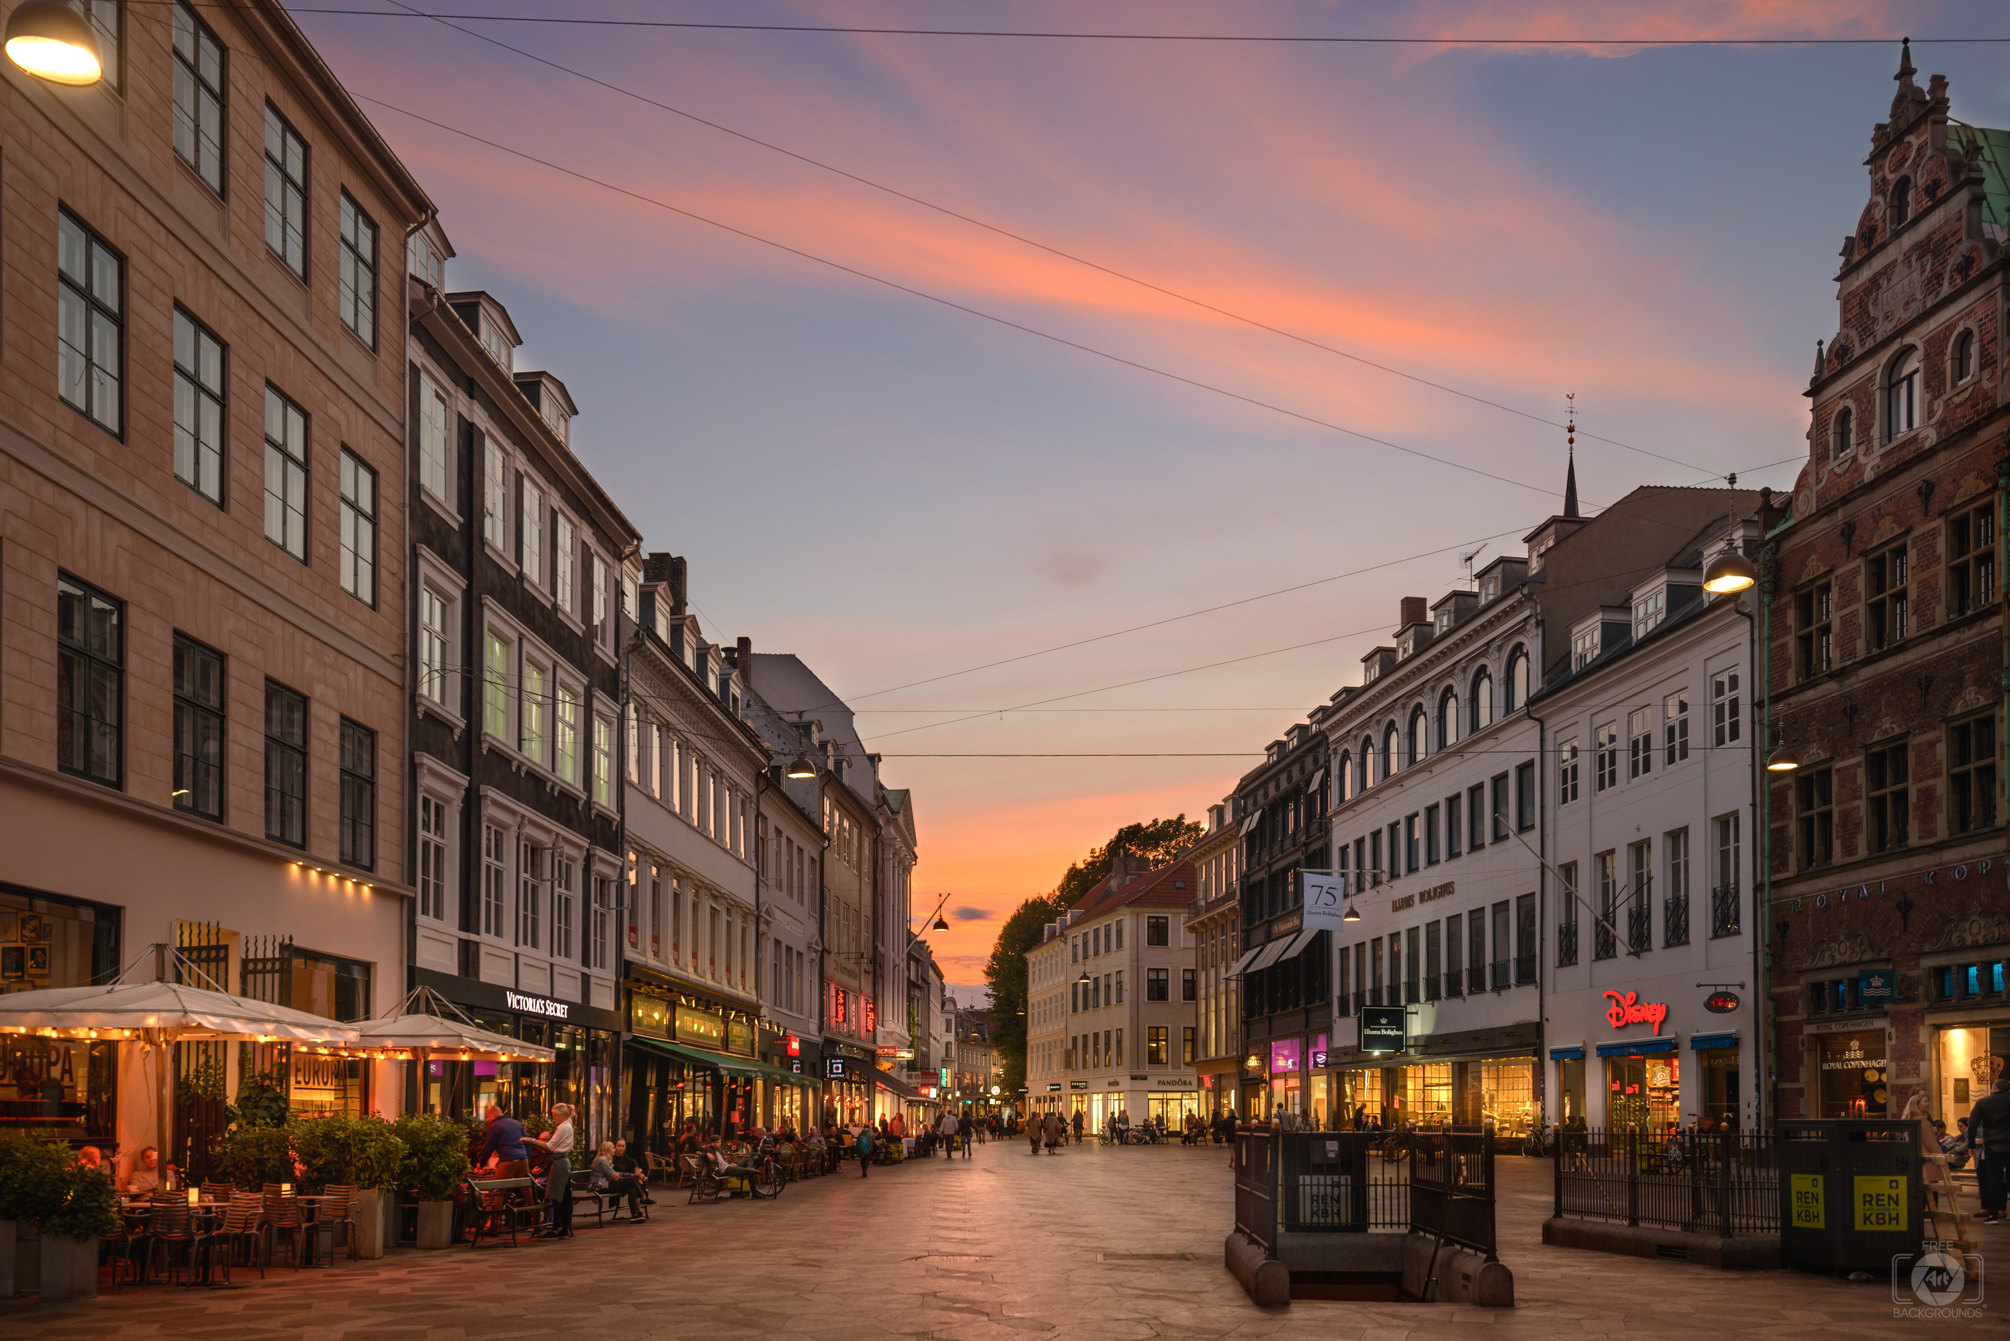
Case Study: Stroget
Stroget used to be a car and pedestrian street in the center of Copenhagen. However, in a dramatic redesign, cars were removed from the street entirely and the entire street pedestrianized. That brought greatly increased foot traffic to this commercial street, supporting local businesses and helping to create a sense of life and vibrancy.
Removing cars entirely is not a reasonable option for East Washington, but as a commercial street in the exact center of the city, it can learn a lot from Stroget in terms of both pedestrianization and human scale. The pedestrian focus of the street has made Stroget a vibrant center of city life and commerce. Businesses extend slightly into the street, benches provide places to sit, and the pedestrian traffic itself creates human-level interest.
Image credits: https://freeartbackgrounds.com/?1514,stroget-street-copenhagen-night-background, https://www.tripsavvy.com/stroget-shopping-area-1626101

Slide 21
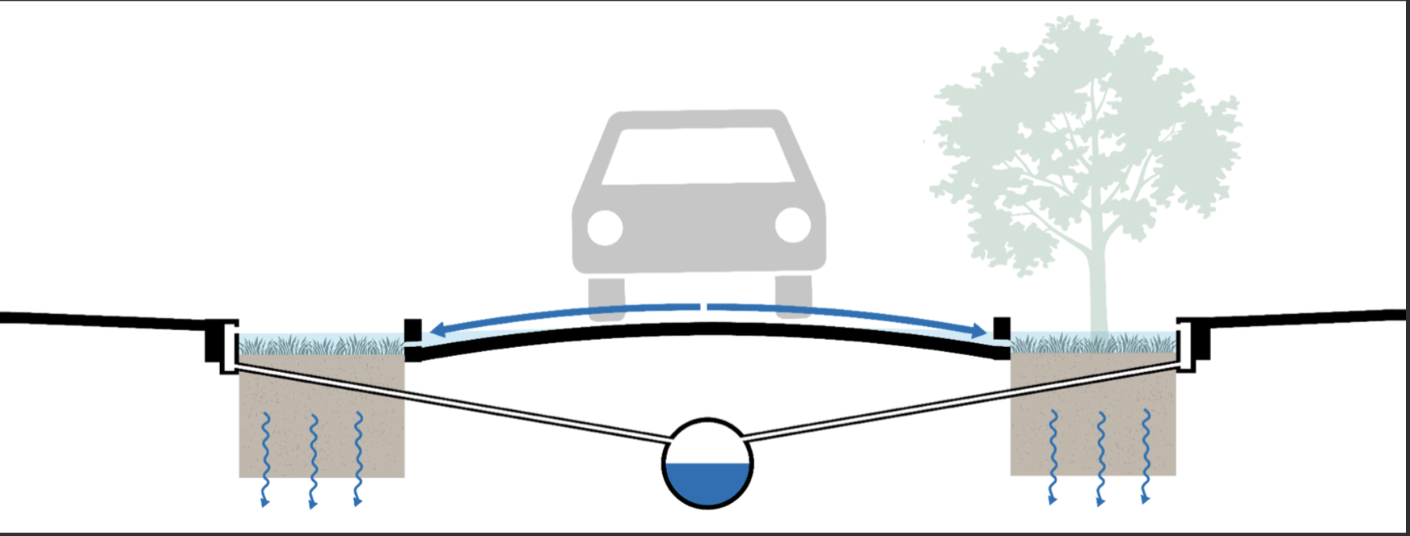
Climate Adaptation: Retention Road
Madison is a city between two lakes, and as natural disasters become more frequent, it will have to improve flood mitigation technology. Any long term construction on East Wash should consider the option of making it into a retention road.
Retention roads filter water into a small reservoir on the sides of the road. They require wide roads or some element, such as parking space, to be removed to make space for the infiltration area. East Washington is the perfect candidate for this adaptation because removing an element of the road to make space for green space would contribute to both of our livability strategies for the street.
The basic structure of a retention road. The curve of the road directs water to the edges, where it filters through the green space into a reservoir. Infiltration areas can also be placed in a median.
With thanks to Rasmus Ekman.

Slide 22
Pilot Project and Process

Slide 23
Pilot Project
To test the effect of pedestrianization and human-scale interventions, we will put in place a two-week-long pilot project putting in place temporary interventions along just this short stretch of the street. The temporary interventions will be:
Closing down one lane of car traffic in each direction, moving the bike and parking lane to take up that space, and placing human-scale interventions such as food trucks, temporary greenery, and makeshift parklets in the new space (blocked off by bollards for safety)
Food trucks are a time-honored Madison tradition, and many local entrepreneurs start out running a food truck rather than a full restaurant. Inviting food trucks into the space as part of our intervention allows the city to support small businesses and the growing diversity of our food scene.
Bringing in temporary seating and allowing local businesses to expand outdoor seating into parklets to provide pedestrians with places to sit and stay
Using bollards and temporary paint to create temporary curb extensions at Baldwin-East Washington intersection

Slide 24
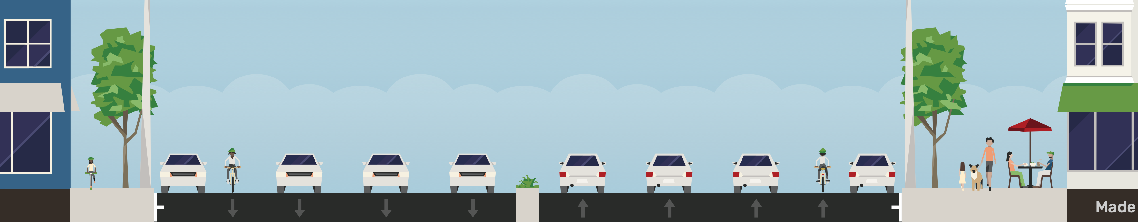
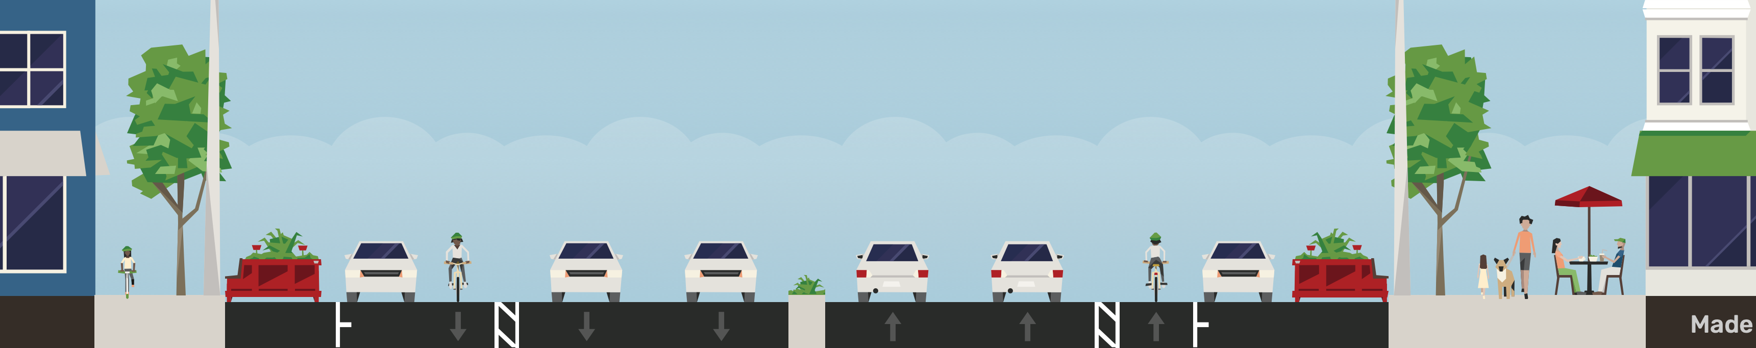
Pilot Project Cross-Section
Current
Pilot

Slide 25
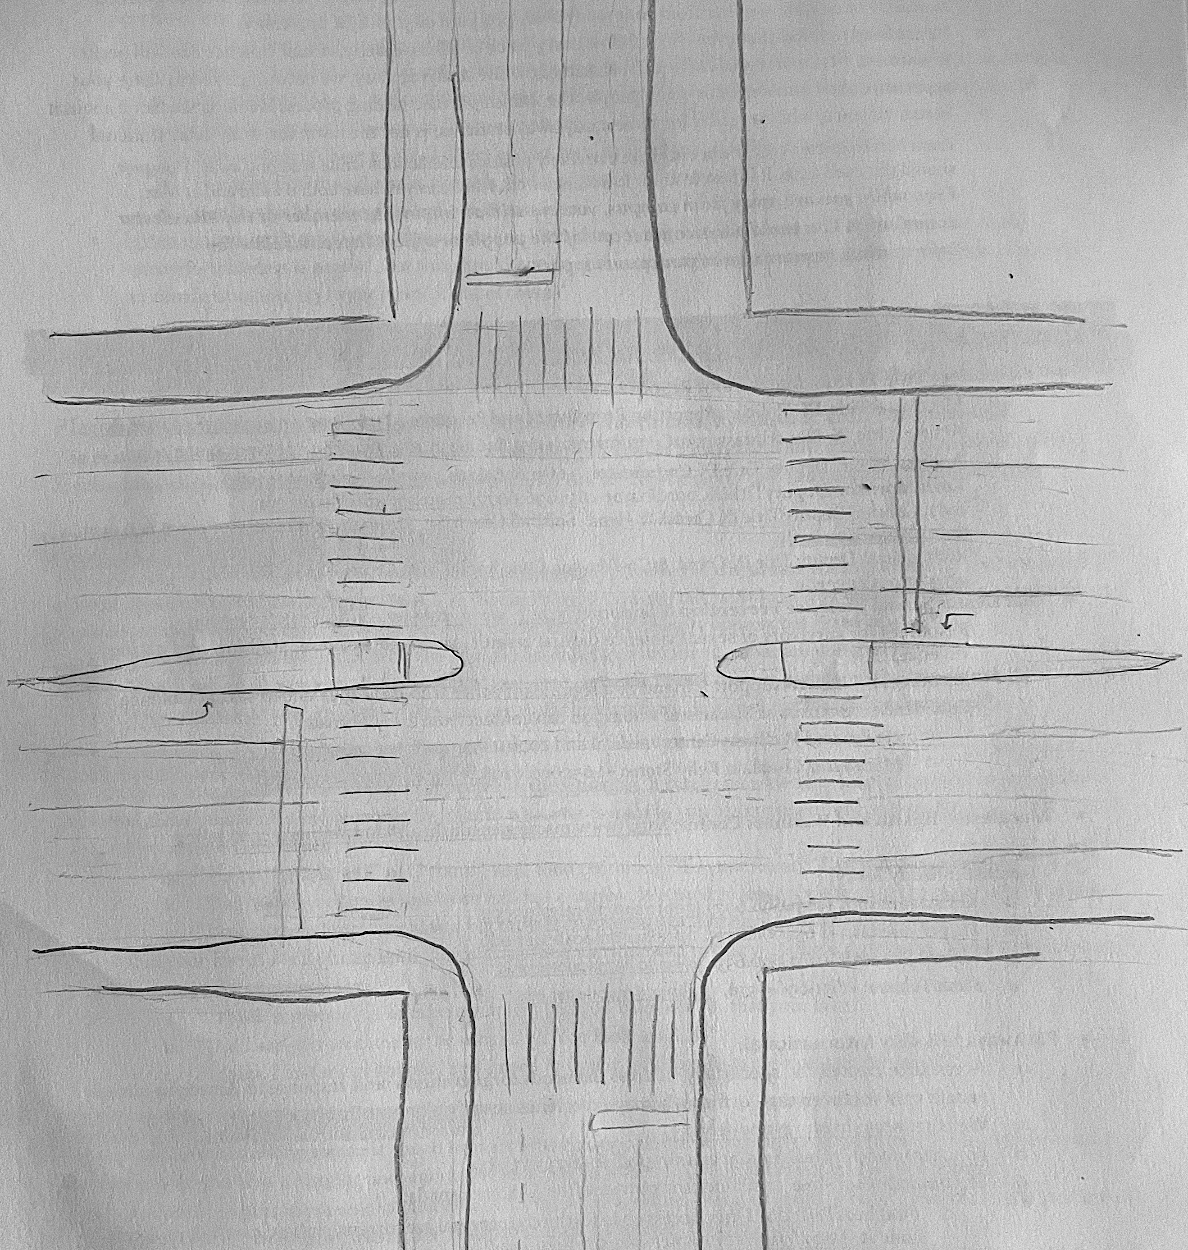
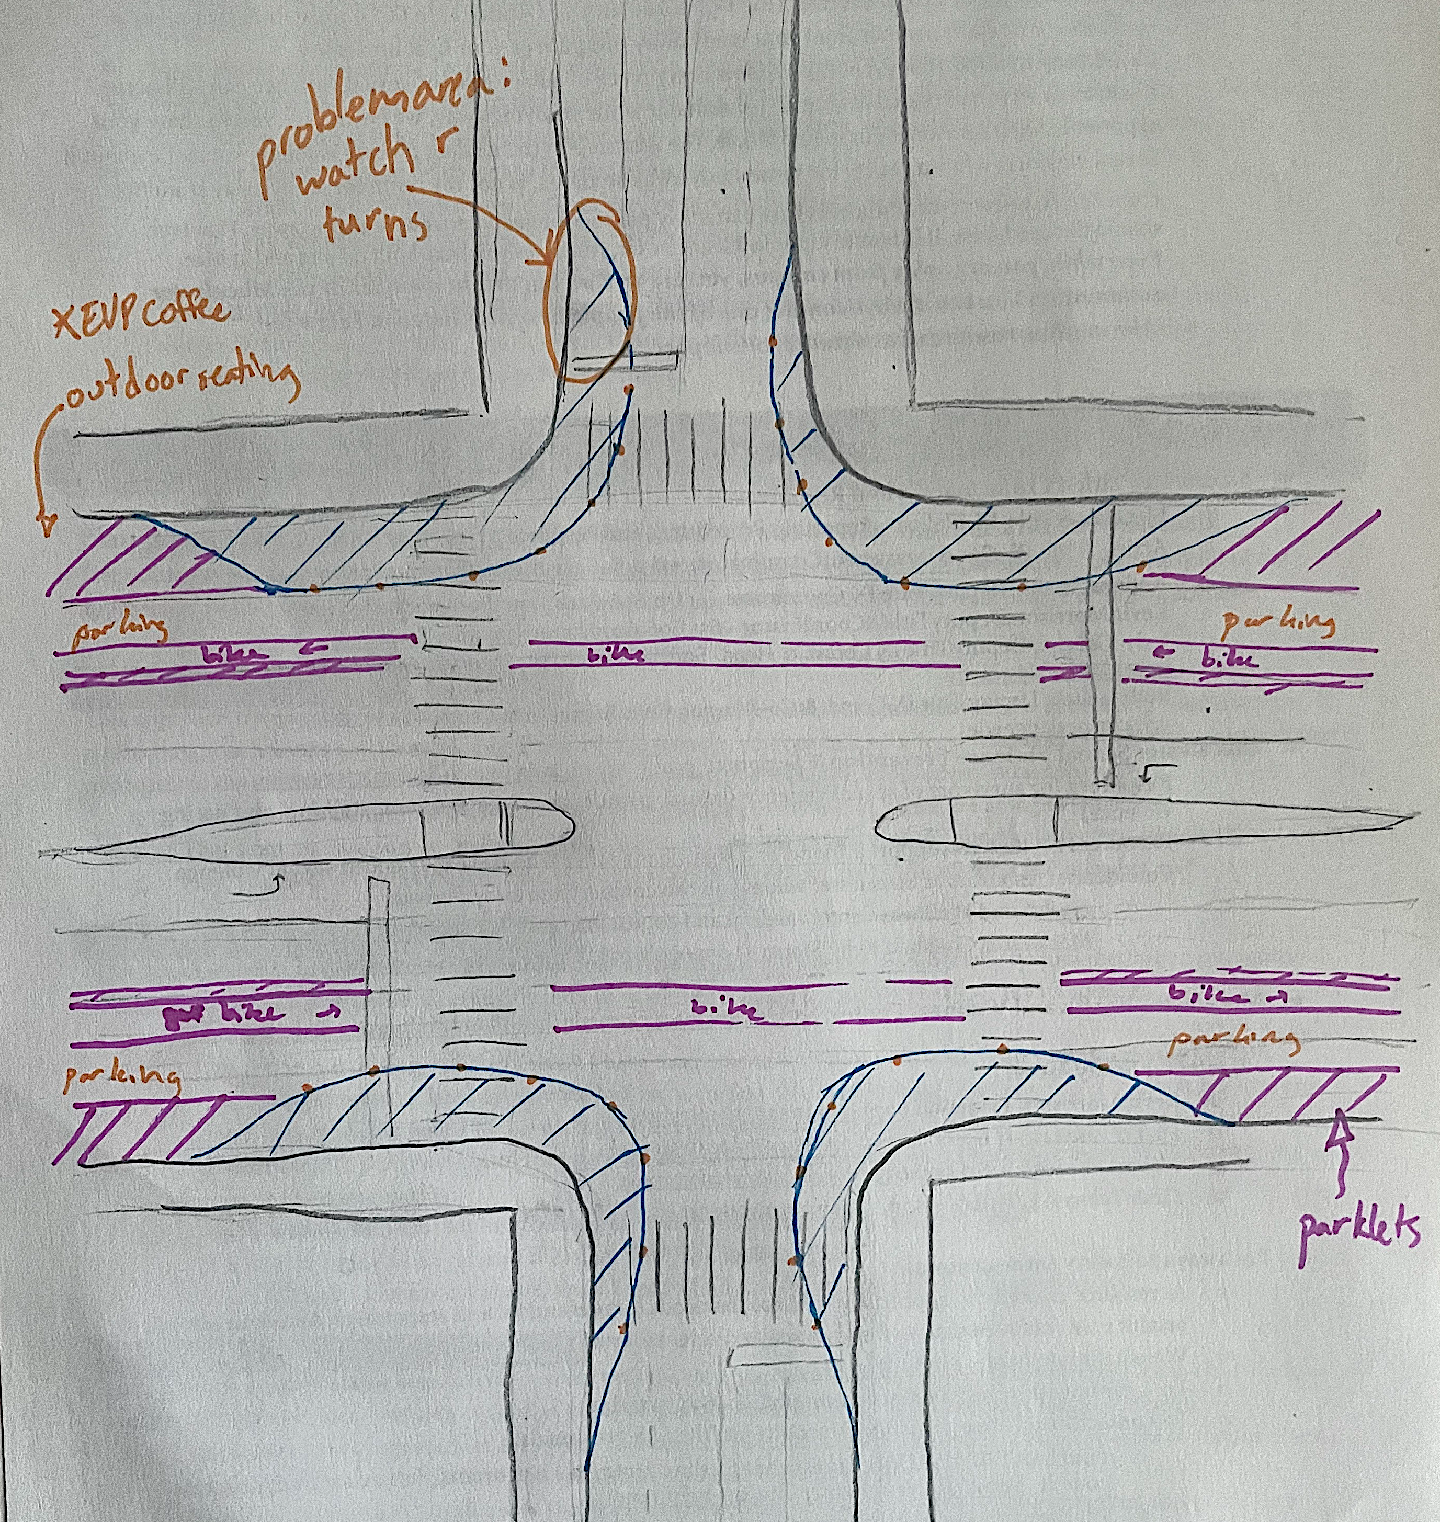
Baldwin-East Washington Intersection
Left: A simple sketch of the intersection as it is now.
Right: The intersection with temporary interventions. Note moved bike and parking lane, curb extensions, and space blocked off for parklets, food trucks and outdoor seating.

Slide 26
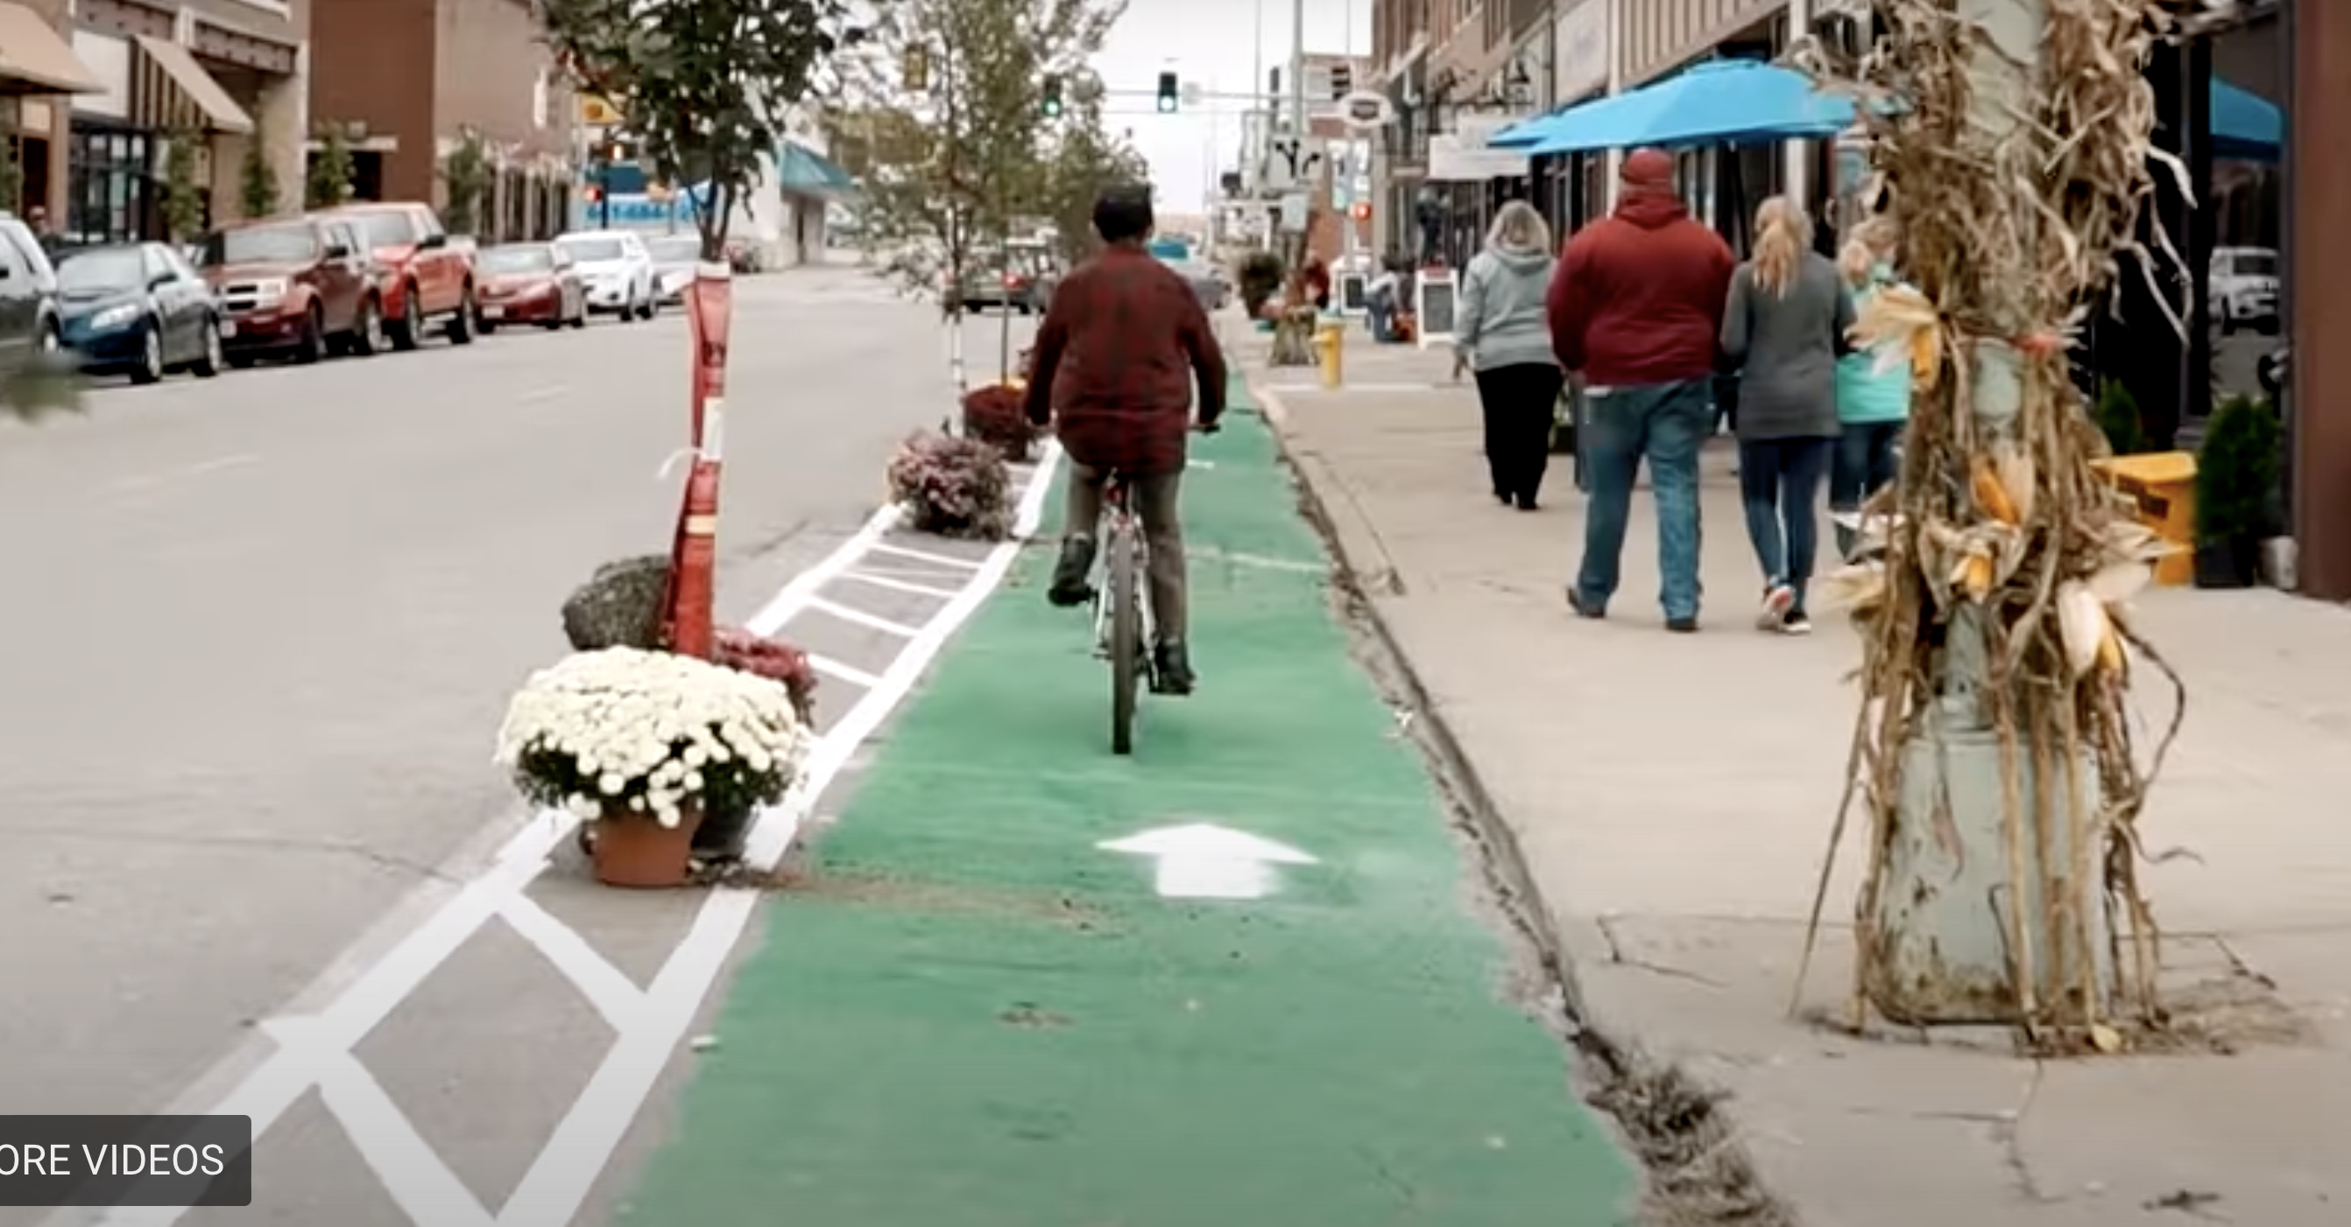
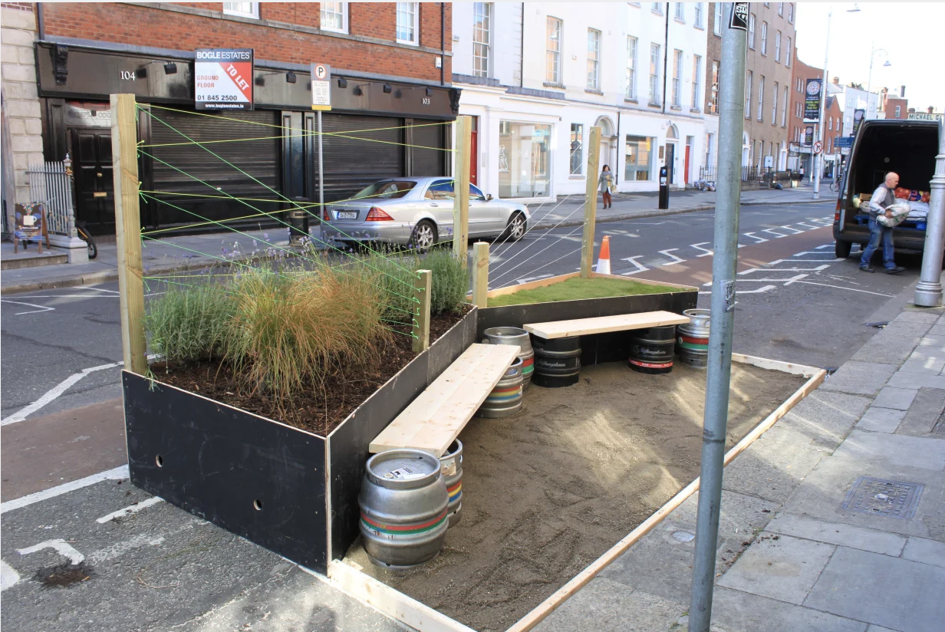
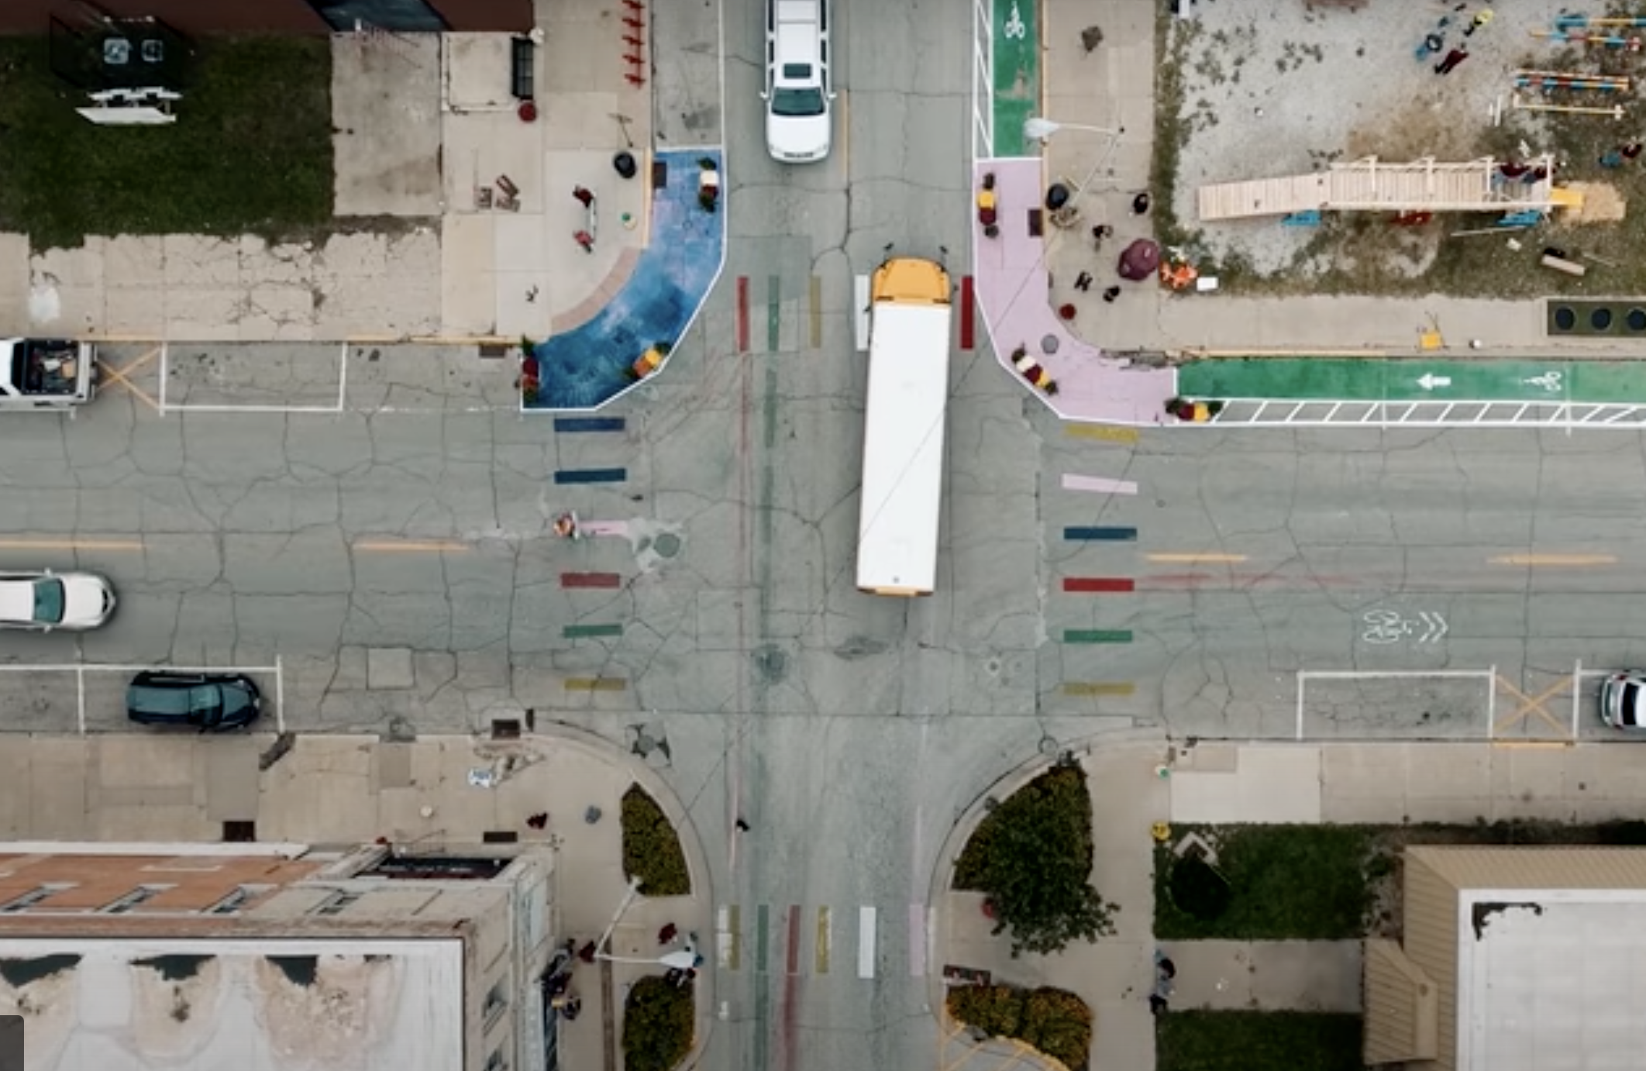
For Reference:
Top: A temporary bicycle lane on Main Street of Ottumwa, IA (Better Block). Temporary buffers like this can create human scale and extend pedestrian space (when not occupied by a bike lane).
Right: Temporary curb extensions from the same project. Painted curb extensions, rather than classic white markings, help demonstrate to cars that they need to avoid the space (Manuel Calvo).
The first parklet in Ireland. This temporary parklet was built for a two-week stay to test how effective parklets would be on this street in Dublin. Similar temporary installations could test out different design concepts and ways to provide pedestrian space on East Washington. (https://commondesigns.wordpress.com/2012/09/23/dublins-first-parklet/)

Slide 27
Collecting Pilot Project Data
It’s important to use the pilot project as a chance to get an understanding of what interventions work on East Wash. Thus, we will collect qualitative data on street use before and during the project, focusing particularly on:
Pedestrians walking on sidewalks and crossing the street
Pedestrians sitting or staying in the space
Dangerous car-pedestrian or car-bike interactions
How pedestrians feel about the space (through interviews)

Slide 28
Process
Stage 1: Community Support | Stage 2: Involving the City | Stage 3: Project Approval | Stage 4: Data Collection | Stage 5: Final Design
Reach out to community stakeholders: businesses on the street, local community organizations (Madison Youth Arts, Wil-Mar Neighborhood Center). Get feedback and support on initial project proposal. | Propose revised project to the office of the Mayor. Involve also Department of Planning, Community and Economic Development. | Project will go through necessary channels in city government, likely including Transportation, Community Development, Streets & Recycling, Traffic Engineering, and possibly Metro Transit (as it is near the Metro Transit Center). | Reach out to UW-Madison or Madison College to involve students in preliminary data collection on space use. | In collaboration with the city and involved businesses, including food trucks and potential parklet sponsors, the design is finalized. Materials are secured.
Stage 6: Project Installation | Stage 7: Project Tenure and Further Data Collection | Stage 8: Evaluation
Project will be installed over a weekend by volunteers. Potential collaborators include Madison Youth Arts, UW-Madison School of Engineering, Madison College, Sector 67, East High School, and any interested local businesses. | College students or other data collectors will monitor activity on the street at different hours. Food trucks and community installations are invited to occupy the space in a schedule finalized in the design stage. | Once the project is over and has been taken down over another weekend, data can be cleaned and evaluated. This would be a great place to involve the UW’s American Family Data Science Institute.
Stakeholders Key
Civil Society
Government
Private Sector
Education

Slide 29
Sources Cited
Boliger, Almene. “Trygt og skønt boligområde - En designguide til social bæredygtighed.” Center for Byplanlægning, Teknik- og Miljøforvaltningen, Københavns Kommune, n.d.
Gehl, Jan. Cities for People. Washington, DC: Island Press, 2010.
Global Designing Cities Initiative. and National Association of City Transportation Officials. Global Street Design Guide. 1st edition. Washington: Island Press, 2016.
Hermansen, Bianca, Bettina Werner, Hilde Evensmo, and Michela Nota. “The Human Habitat: My, Our, and Everyone’s City.” In Integrating Human Health into Urban and Transport Planning: A Framework, edited by Mark J. Nieuwenhuijsen and Haneen Khreis, 113–33. Cham, Switzerland: Springer, 2019. https://search.ebscohost.com/login.aspx?direct=true&scope=site&db=nlebk&db=nlabk&AN=1850331.
Jacobs, Jane, and Jason Epstein. The Death and Life of Great American Cities. New York: Modern Library, 1961.
Jolles, Ward. “Madison’s Most Dangerous Road: The Uphill Fight to Make East Washington Avenue Safer.” News Source. WKOW, November 4, 2021.
National Association of City Transportation Officials. “Conventional Crosswalks,” July 11, 2013. https://nacto.org/publication/urban-street-design-guide/intersection-design-elements/crosswalks-and-crossings/conventional-crosswalks/.
National Association of City Transportation Officials. “Curb Extensions.” Accessed December 11, 2022. https://nacto.org/publication/urban-street-design-guide/street-design-elements/curb-extensions/.
National Association of City Transportation Officials. “Lane Width,” July 11, 2013. https://nacto.org/publication/urban-street-design-guide/street-design-elements/lane-width/.
National Association of City Officials. “Midblock Crosswalks,” July 11, 2013. https://nacto.org/publication/urban-street-design-guide/intersection-design-elements/crosswalks-and-crossings/midblock-crosswalks/. Transportation
Mosiman, Dean. “Madison City Council Approves Sweeping Metro Transit Network Redesign.” News Source. madison.com, June 8, 2022. https://madison.com/news/local/govt-and-politics/madison-city-council-approves-sweeping-metro-transit-network-redesign/article_d44fb542-5fd2-5cd6-abb2-1efb0b50cd04.html.
“Placemaking | Better Block | Dallas.” Accessed December 11, 2022. https://www.betterblock.org/.
Robinson, Lucas. “Those Traffic Cones on East Wash? It’s the Start of Bus Rapid Transit Construction.” News Source. madison.com, December 1, 2022. https://madison.com/news/local/govt-and-politics/those-traffic-cones-on-east-wash-its-the-start-of-bus-rapid-transit-construction/article_94273d5d-703f-5c81-9594-ad5be7d756d0.html.
“Vision Zero Projects | Transportation, City of Madison, Wisconsin.” City of Madison Department of Transportation. Accessed December 11, 2022. https://www.cityofmadison.com/transportation/initiatives/vision-zero/vision-zero-projects.
VisitCopenhagen. “Dronning Louises Bro | Bridge.” Accessed December 11, 2022. https://www.visitcopenhagen.com/copenhagen/planning/dronning-louises-bro-gdk699876.

